Slide 1
Operating System Security
CIS 483 – Database Security
Computer Information Systems
University of Louisville
Ghiyoung Im, PhD

Slide 2
Lesson Objectives
At the end of the course, students will be able to:
Understand Windows Security
Describe SIDs and SATs
Describe Active Directory
Describe Group Policy Objects
Describe Permissions and Rights
Notes:
Notes

Slide 3
Agenda
Windows Versions
Workgroups
SIDs and SATs
Local vs Domain Accounts
Active Directory
Group Policy Objects
Permissions
Rights & Privilege
Active Directory Demo
Group Policy Objects Demo

Slide 4
MS Windows Client Operating Systems
Windows 3.0 (DOS-based)
Windows 95 (DOS-based)
Windows 98 (DOS-based)
Windows Me (DOS-based)
Windows XP SP2 (NT Kernel-based)
Windows Vista (NT Kernel-based)
Windows 7 (NT Kernel-based)
Windows 8 (NT Kernel-based)

Slide 5
MS Windows Server Operating Systems
Windows NT 4.0
Windows Server 2000
Windows Server 2003
Windows Server 2008
Windows Server 2008 R2

Slide 6
Windows XP
Features unique in XP Professional (XP SP2)
Support Active Directory domain join
IPsec and PKI support
Group Policy support
Data Execution Prevention
Start / Control Panel / System and Maintenance / System / Advanced System Settings / Performance / Settings / Data Execution Prevention
Encrypting File System (EFS)
XP Service Pack 3
WPA2 support

Slide 7
Windows Vista & Windows 7
Security Enhancements
BitLocker Drive Encryption
User Access Control
Use a regular account and get notified when elevated privileges are needed
Start / Control Panel / User Accounts
IE 7.0/8.0/9.0
Windows Firewall with Advanced Security
Tight control over incoming and outgoing connections
Start / Control Panel / Windows Firewall / Advanced Settings
Windows 7 is almost Windows Vista R2

Slide 8
Windows Servers
Windows Server 2003
Active Directory
IIS
Exchange Server
SQL Server
File and Print Server
Network Services (DNS, DHCP, and RADIUS)
Windows Server 2008
2008 R2 support 64-bit only

Slide 9
Workgroups (1)
Computers share information without having domain controllers
Each has control over its own computer only
Access to other computers require account
Peer-to-peer network
Rights and permissions assigned to local users and local groups
Typically about 20 computers
On the same local network
Start / Computer / Properties / Computer name, domain, and workgroup / Change / System Properties / Computer Name / Change

Slide 10
Workgroups (2)
Advantages
Simple to manage
Each protects itself
Less impacted by security incidents
Disadvantages
Not scalable
No single sign-on
No consistent application of group policies
No consistent management of users

Slide 11
Workgroup Scalability
Individual computers do not recognize and accept other users credentials
Workgroup has peer-to-peer structure and doesn’t have a central player
Need a central player:
Has SIDs of all the users in the workgroup for centralized authentication (single sign-on) and authorization
Active Directory
Has a secure protocol for authentication to the resource by delivering the SID
NTLM, Kerberos

Slide 12
How to Manage User Accounts
Each Windows computer has local accounts and groups
Manage local accounts and groups (Windows 7)
Start / Control Panel / User Accounts
Start / Control Panel / Administrative Tools / Computer Management
Command shell
Start / cmd / net.exe help user

Slide 13
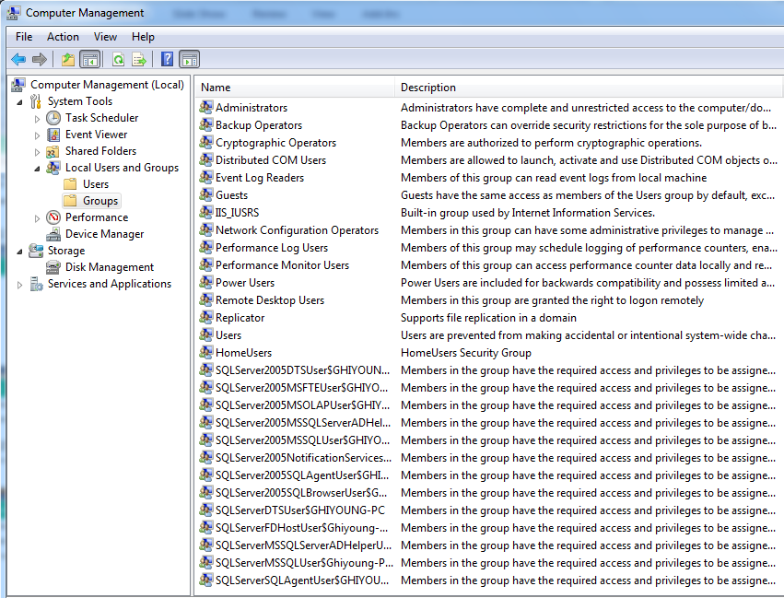
Local Users and Groups

Slide 14
SID (Security Identifier)
A unique ID number assigned to each user, group, and Windows computer
A string of alphanumeric characters
Example: S-1-5-32-1045337234-12924708993-5683276719-19000
Windows uses SIDs, instead of usernames, to enforce permissions and user rights
The Unix equivalent is UID (User ID)
Well-known group SIDs
S-1-1-0 (Everyone)
S-1-5-32-544 (Local Administrators group)
Reference: Wiki

Slide 15
Security Access Token (SAT)
After successful authentication, a SAT is issued. SAT consists of:
SID of the user account
SIDs of the user groups
User rights and privileges
The SAT is attached to every process initiated by the user
The access to a resource is allowed only if the security principals contained in the SAT have the rights and permissions
To view SAT: whoami.exe /all /fo list
Reference: MSDN

Slide 16
Active Directory
Active Directory (AD)
A database that stores user accounts on a Windows Server
Domain
A collection of users, computers, and groups in the AD database
Domain Controller
A server that manages the AD database
The AD database has the SIDs of all of the users, computers, and groups in the domain
Access Control List (ACL)
Each resource (database, file, printer, etc) has a list of SIDs with the permissions of each SID to the resource

Slide 17
Authentication Protocol
Users request access to Servers. SATs are created at the Server computer in which the user wants to access to a resource.
The followings are transmitted via the authentication protocol
The SIDs of the user’s domain account
The SIDs of the domain groups of the user
Authentication protocols
Kerberos (requires AD)
NTLMv1 (don’t use – vulnerable)
NTLMv2

Slide 18
Group Policy
A set of rules that control the behavior of user accounts in a domain. It controls what users can and cannot do on a computer system in a domain.
A centralized management of configuration of user’s accounts, applications, and operating systems.
Group Policy Objects (GPOs)
Configuration scripts that are automatically applied to computers
At boot-up, logon, and periodically (90-120 minutes)

Slide 19
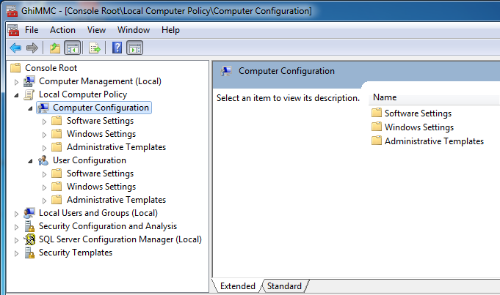
Local Group Policy

Slide 20
Permissions
A user or group is granted to access for an object or object property
Objects include files, Active Directory objects, registry objects, or system objects (e.g., processes)
Recommendation: Role based access controls (RBAC) via nested groups in a Active Directory domain
Permissions common to most of objects:
Read; Modify; Change owner; Delete
Managing permissions on a file:
Right-click the file name / Properties / Security

Slide 21
Role Based Access Controls (RBAC)
AGDLP ("account, global, domain local, permission")
Accounts
Have a unique account for each user
Global Groups
Add user accounts to Global groups according to job descriptions, locations, shared needs
Local Groups
Add Global Groups to Local Groups on the computers that have resources to be secured
Permissions and Rights
Assign permission and rights for the Local groups to the objects to be secured

Slide 22
Assigning Permissions in Windows and UNIX
Category | Windows | UNIX
Number of permissions | 6 standard, 13 specialized if needed | Only 3: read (read only), write (make changes), and execute (for programs). Referred to as rwx
For a file or directory, different permissions can be assigned to | Any number of individual accounts and groups | The account owner A single group, and All other accounts
* Panko, 2011

Slide 23
Principle of Least Privilege
Definition
This “requires that each subject in a system be granted the most restrictive set of privileges (or lowest clearance) needed for the performance of authorized tasks. The application of this principle limits the damage that can result from accident, error, or unauthorized use” – DoD Trusted Computer System Evaluation Criteria
A good example
System: Full control
Administrator: Full control
Creator/Owner: Full control
Authenticated Users: Read and Execute (or Modify)

Slide 24
User Rights and Privileges
Rights are related to a specific system
Listed in your SAT
Managed by GPOs
Managing user rights
Administrative Tools / Local Security Policy / Local Policies / User Rights Assignment

Slide 25
User Rights Example
Take ownership of files or other objects
Allow one to take ownership of any securable object
Owners of the objects have full control of them, and can change their permissions regardless of the current permissions
Only assign this to trusted users
It defaults to Administrators

Slide 26
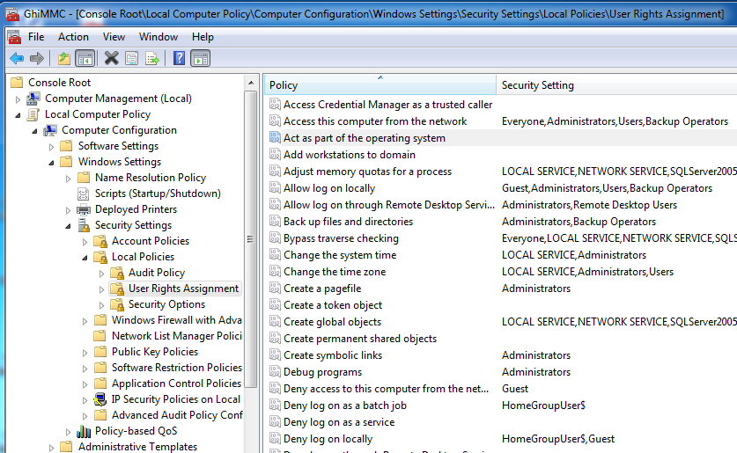
Managing User Rights

Slide 27
Active Directory Demo

Slide 28
Group Policy Objects (GPO) Demo

Slide 29
Next Week
A guest speaker is coming
Miller IT Center (5:40 pm -6:10 pm)
In-class Lab is scheduled
Read the lab material posted before the class

